Slide 1
Network devices

Slide 2
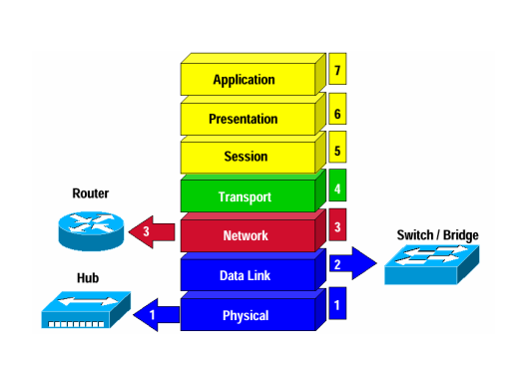
OSI model
7. Application layer
Consists of application programs that use the network.
6. Presentation layer
Standardizes data presentation to the applications that use the network.
5. Session layer
Manages sessions between applications.
4. Transport layer
Provides end-to-end error detection and correction.
3. Network layer
Decides which physical path the data will take.
2. Data link layer
Provides reliable data delivery across the physical link.
1. Physical layer
Defines the physical characteristics of the network media.

Slide 3
Hub vs. Switch

Slide 4
Routers

Slide 5
Network devices
Hub
Broadcast packets
Switch
Forward packet to destination interface
Router
Change source MAC address and then forward packet to destination interface

Slide 6
Comparison
Hub | Switch | Router
HUB work on Physical Layer of OSI Model | Switch work on Data Link Layer of OSI Model | Router work on Network Layer of OSI Model
HUB is Broadcast Device | Switch is Unicast/Multicast Device | Router is a routing device use to create route for transmitting data packets
Hus is use to connect device in the same network | Switch is use to connect devices in the same network | Router is use to connect two or more different network.
Hub sends data in the form of binary bits | Switch sends data in the form of frames | Router sends data in the form packets
Hub only works in half duplex | Switch works in full duplex | Router works in full duplex
Only one device can send data at a time | Multiple devices can send data at the same time | Multiple devices can send data at the same time
Hub does not store any mac address or IP address | Switch store MAC Address | Router stores IP address

Slide 7
Hub function
$ sudo python topo1.py
# ifconfig -a
Lan1: h1, h2, h3
Lan2: h4
Correct subnet mask of h2-eth0:
# ip addr flush dev h2-eth0
# ip addr add 10.0.0.2/24 dev h2-eth0

Slide 8
Hub function
Configure s12 and s34 as a hub:
mininet> sh ovs-ofctl add-flow s12 action=flood
mininet> sh ovs-ofctl add-flow s34 action=flood
h1 ping h2

Slide 9
Switch function
Return s12 to a switch:
mininet> sh ovs-ofctl add-flow s12 action=normal
Delete a specified entry of ARP cache:
# arp -d 10.0.0.2
h1 ping h2
h1 ping h4
h1 ping h3

Slide 10
Router function
mininet> exit
$ sudo mn -c
$ sudo python topo2.py
mininet> pingall

Slide 11
Router function
Enable IP forwarding on r1:
# echo 1 > /proc/sys/net/ipv4/ip_forward
mininet> pingall
Show gateway of each host:
# ip route
Correct gateway:
# ip route del default via 10.0.0.101
# ip route add default via 10.0.0.100

Slide 12
Routing with multiple hops
For h3:
# echo 1 > /proc/sys/net/ipv4/ip_forward
# ip route del default via 10.0.1.100
For r1:
# ip route add default via 10.0.1.3
h1 ping h3
h2 ping h3
# ip route add 10.0.0.0/24 via 10.0.1.100

